Slide 1
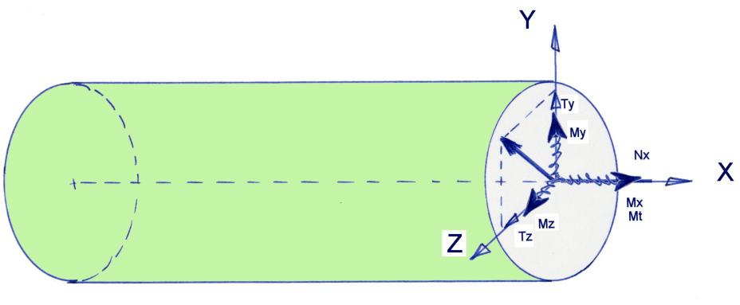
Beams with several loads
On a cross section, in the most general case, there is :
One Normal force,
Two Shear Forces,
A Twisting Moment,
Two bending Moments
Several Loads - CAUC- 2011

Slide 2
Beams with several loads
Assumption :
The result is the sum of the results computed for each simple sollicitation,
The cross section, initially a plane, after the load is applied, is still in a lane. There is no warping.
The displacement of the cross section is :
A translation of the cross section,
A rotation
Several Loads - CAUC- 2011

Slide 3
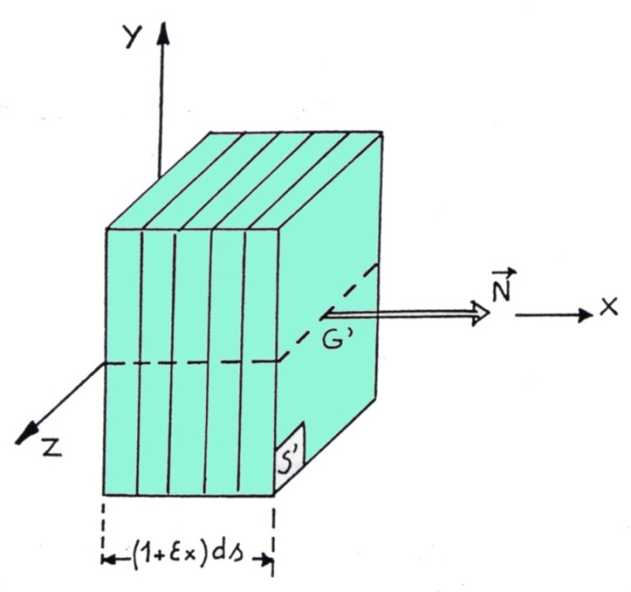
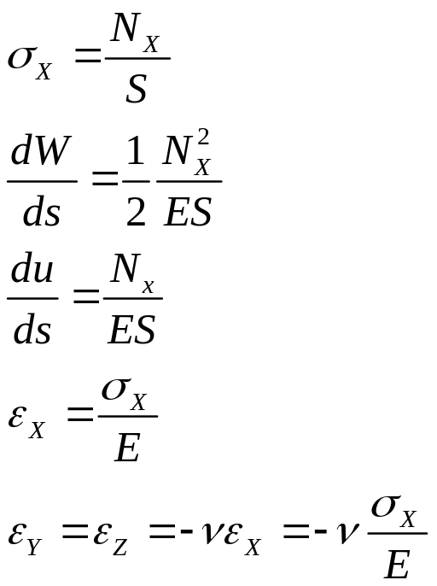
Normal Force
The displacement of the cross section is a translation in the direction X
Several Loads - CAUC- 2011

Slide 4
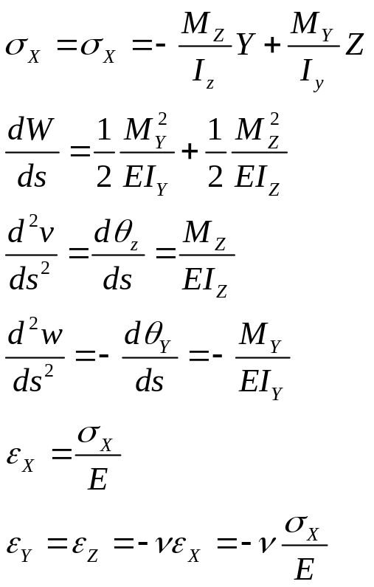
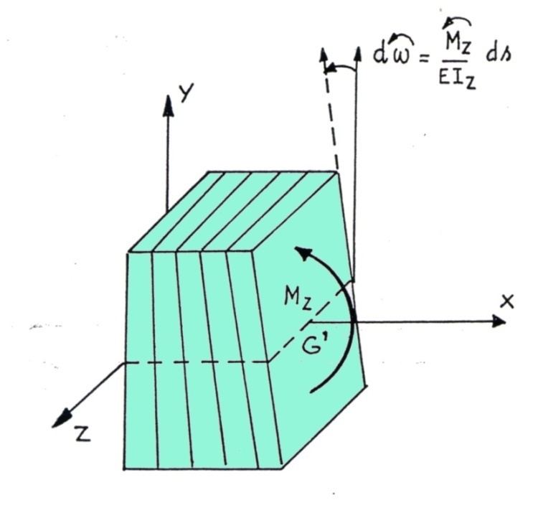
Bending Moment
The displacement of the cross section is a rotation around the axis GY and GZ
Several Loads - CAUC- 2011

Slide 5
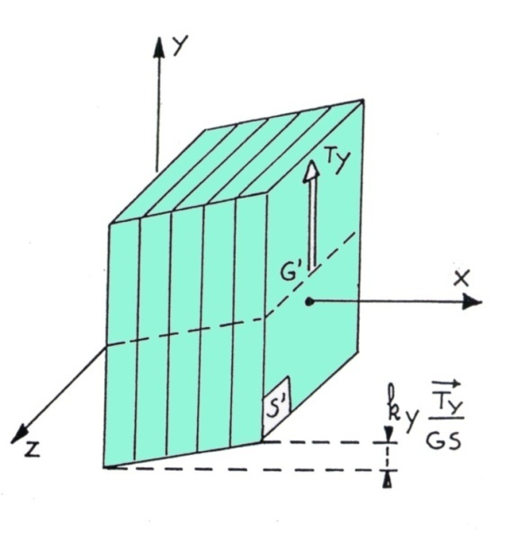
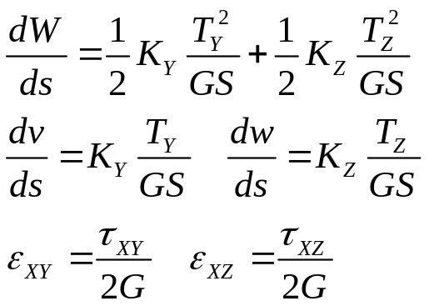
Shear Force
The displacement of the cross section is a translation in the direction Y and the direction Z
Several Loads - CAUC- 2011

Slide 6
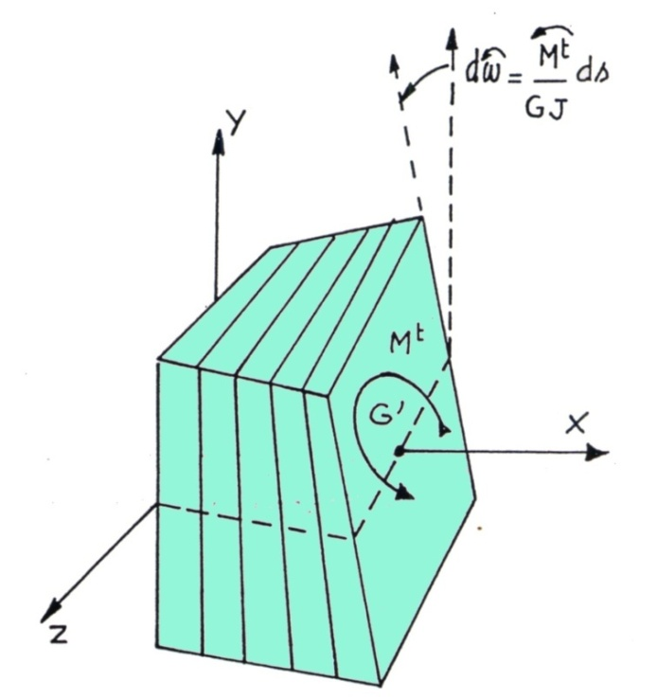
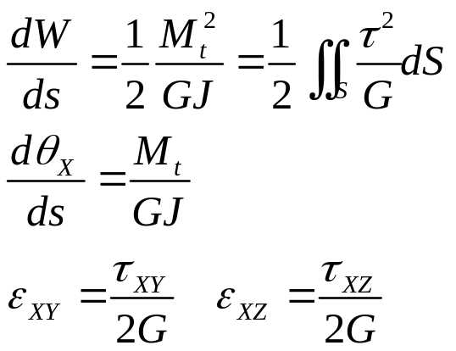
Twisting moment
The displacement of the cross section is a rotation around the axis CX
Several Loads - CAUC- 2011

Slide 7
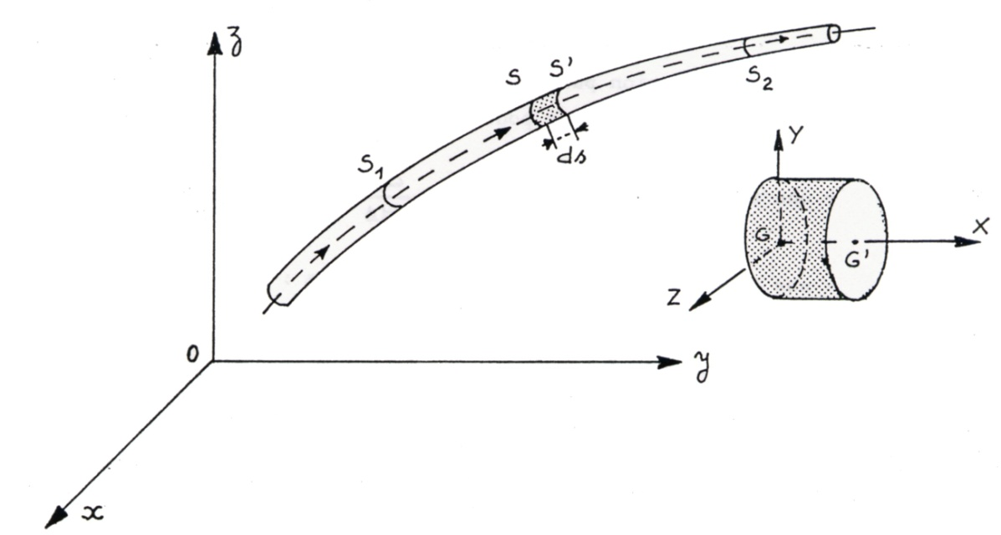
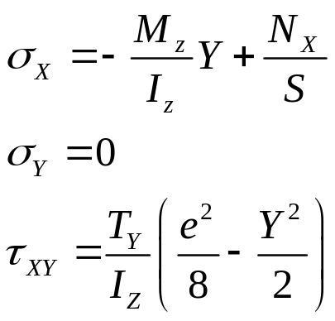
Bresse’s Formula
Several Loads - CAUC- 2011

Slide 8
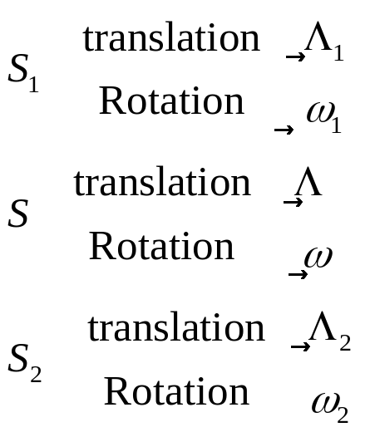
Bresse’s Formula
Several Loads - CAUC- 2011

Slide 9

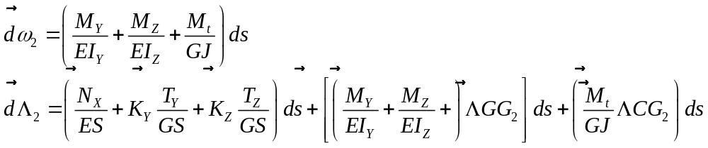
Bresse’s Formula
Several Loads - CAUC- 2011

Slide 10

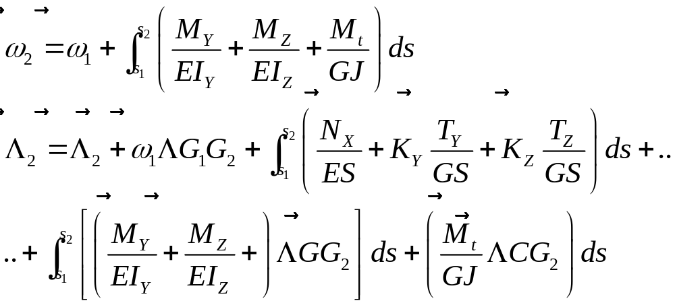
Bresse’s Formula
Several Loads - CAUC- 2011

Slide 11
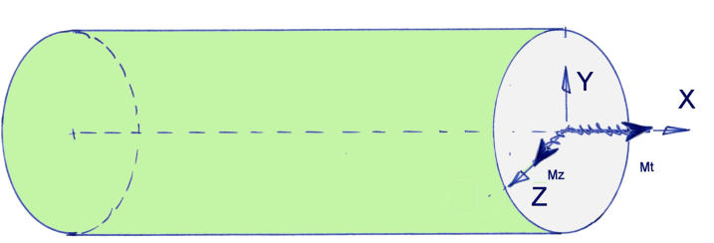
Exemple shaft transmission
A shaft, usually a cylindrical bar, is used for transmitting motion to a wheel, a gear box…
On a cylindrical shaft transmission, whose radius is r, and lenght is L, deux torques are applied :
a pure bending moment Mz=M
a pure twisting moment Mt=M
Remark : a shaft, usually a cylindrical bar, is used for transmitting motion to a wheel, a gear box…
Several Loads - CAUC- 2011

Slide 12
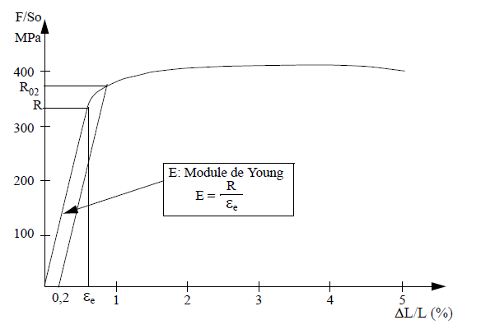
Criterion
TRESCA : The maximum state of stress in a point is reached when the shear stress reaches a critical value on a facet.
VON MISES : The maximum state of stress in a point is reached when the internal energy inside the deviator tensor reaches a critical value.
Theses critical values are defined by a test.
Several Loads - CAUC- 2011

Slide 13
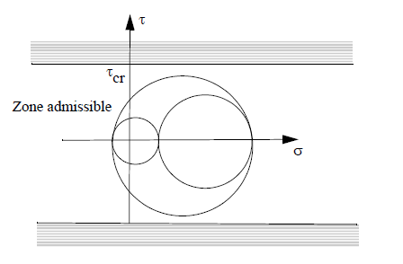
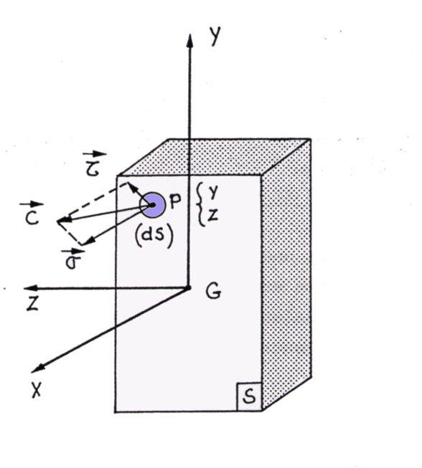
Tresca’s Criterion
Several Loads - CAUC- 2011

Slide 14
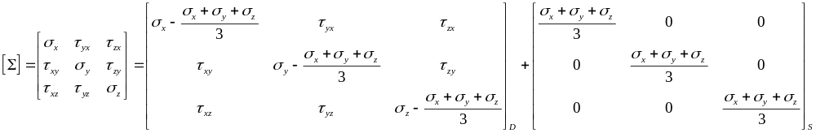
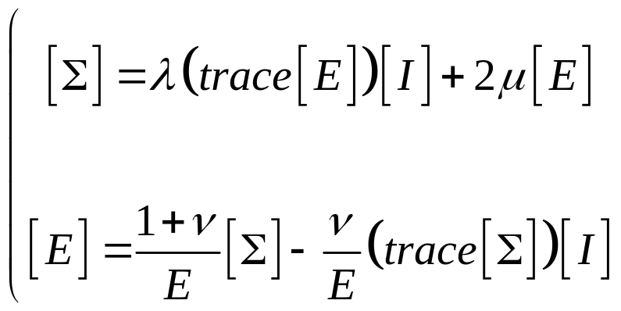
Von Mises’s Criterion
Several Loads - CAUC- 2011

Slide 15

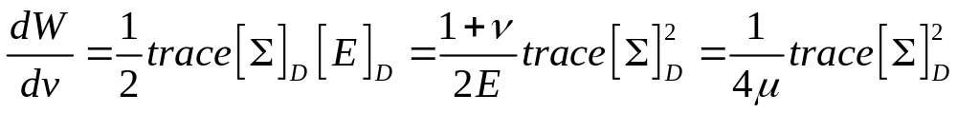
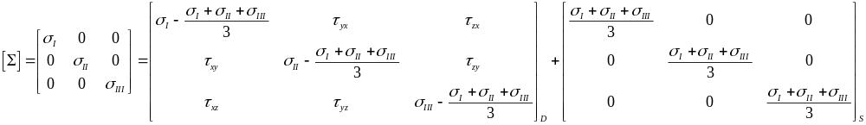
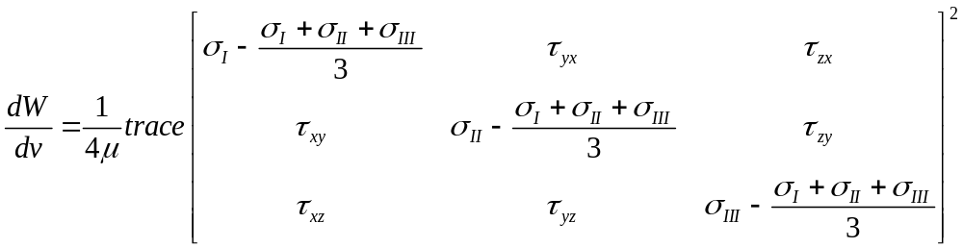
Von Mises’s Criteria
Several Loads - CAUC- 2011

Slide 16
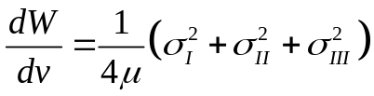
Von Mises’s Criteria
Several Loads - CAUC- 2011

Slide 17
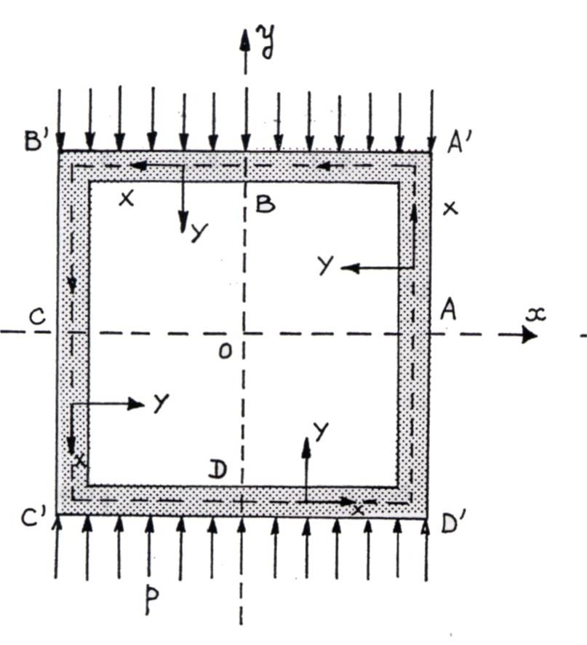
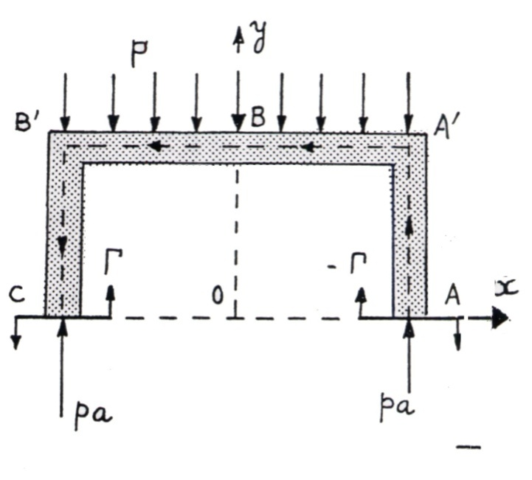
Frame 1
Several Loads - CAUC- 2011

Slide 18
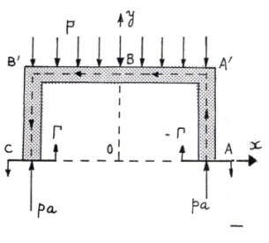
Frame 1
Several Loads - CAUC- 2011

Slide 19
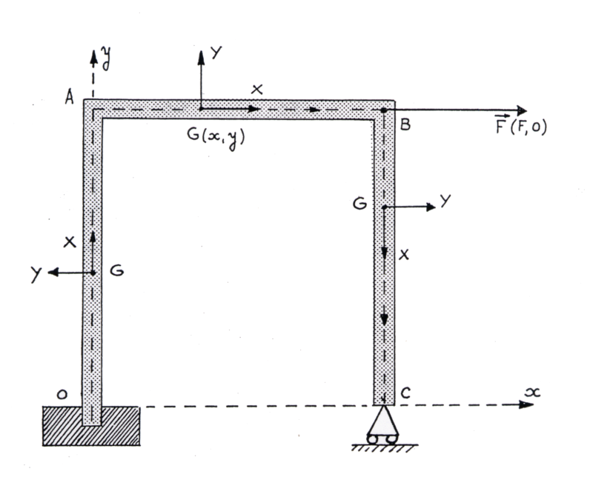
Frame 2
Several Loads - CAUC- 2011

Slide 20
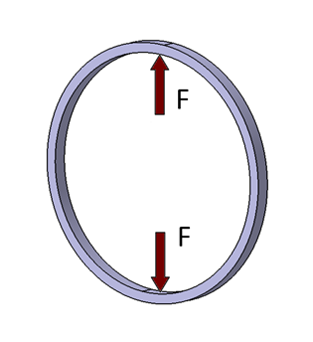
Frame 3 : Dynamometer ring
Width: 30 mm
Internal radius: 240 mm
External radius: 260 mm
Young modulus: 200 000 MPa
Poisson’s ratio: 1/3
F = 5000 N
Several Loads - CAUC- 2011

Slide 21
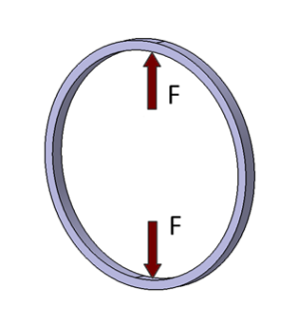
Frame 3 : Dynamometer ring
Several Loads - CAUC- 2011

Slide 22
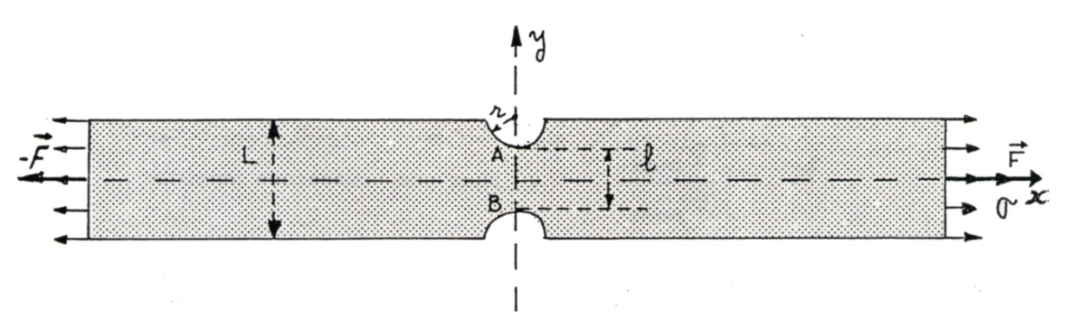
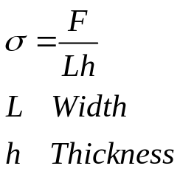
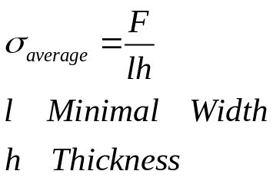
Stress Concentration
Rectangular thin plate, with 2 half holes on the edges
Several Loads - CAUC- 2011

Slide 23
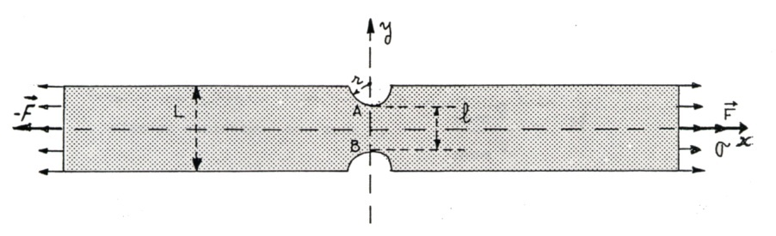
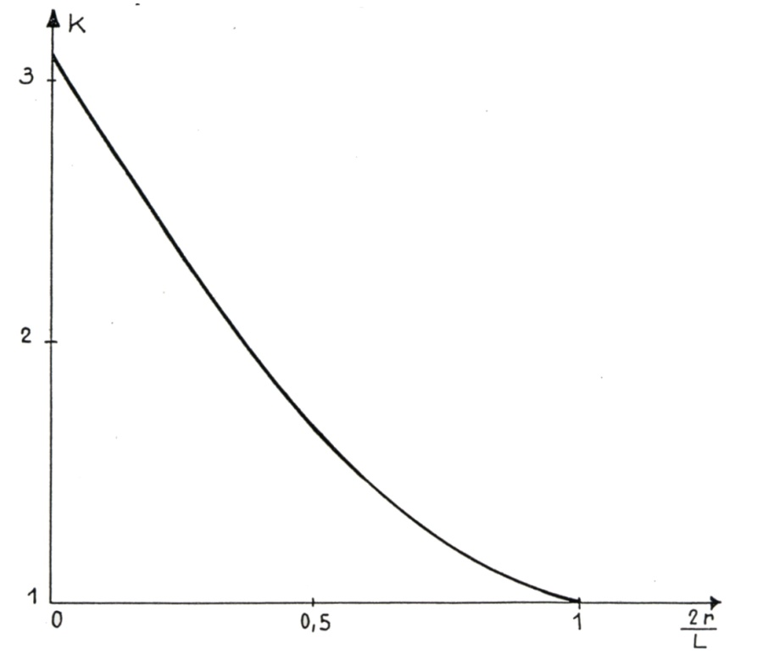
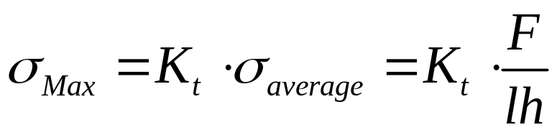
Stress Concentration
Rectangular thin plate, with 2 half holes on the edges
Several Loads - CAUC- 2011

Slide 24
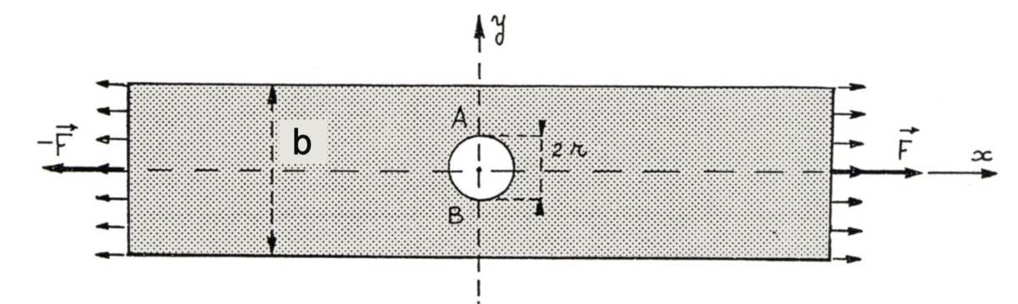
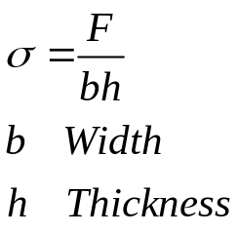
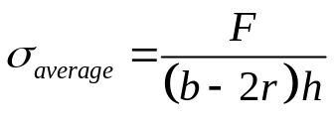
Stress Concentration
Thin plate with a hole
Several Loads - CAUC- 2011

Slide 25
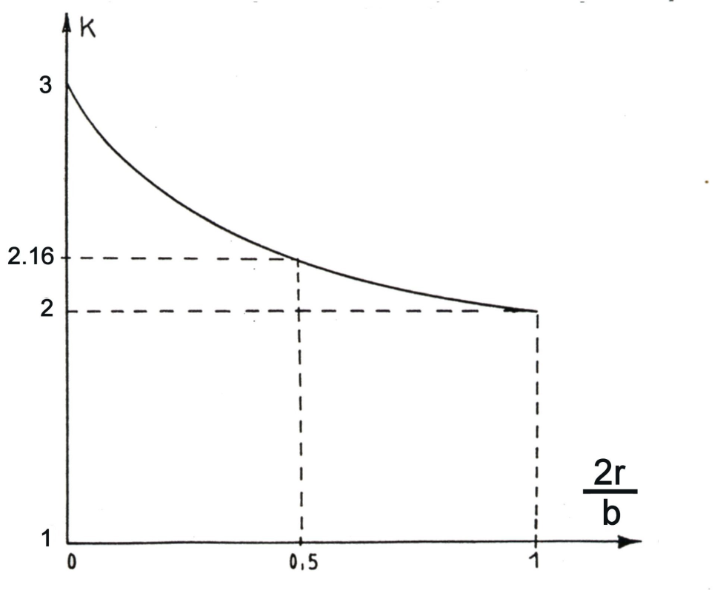
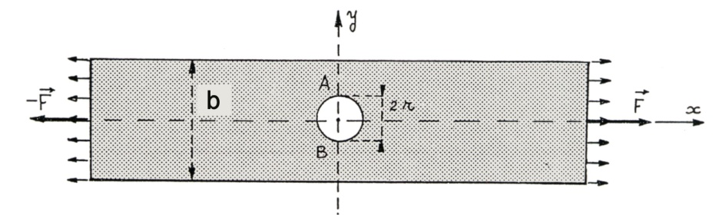
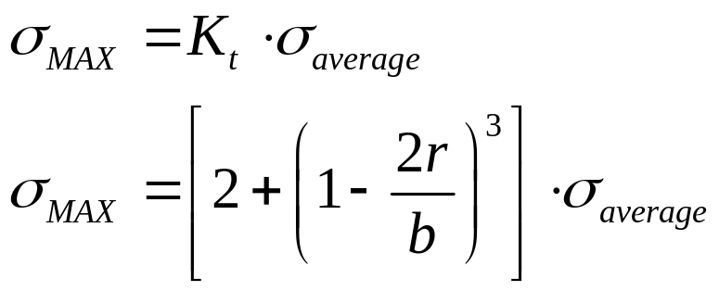
Stress Concentration
Thin plate with a hole
Several Loads - CAUC- 2011

Slide 26

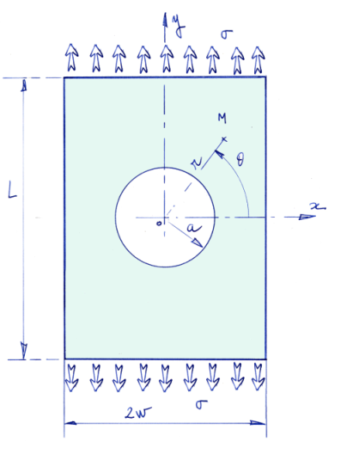
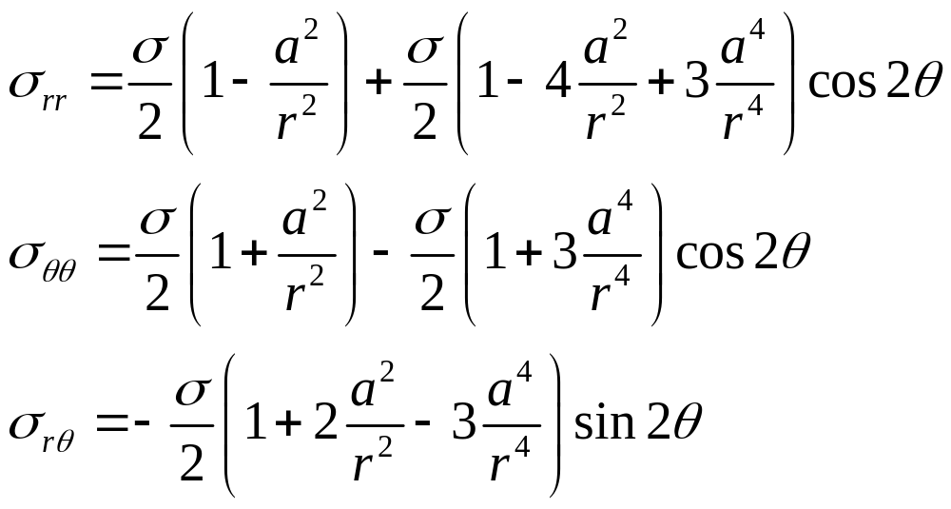
Infinite Plate with a hole : Solution in cylindrical axis
Several Loads - CAUC- 2011

Slide 27
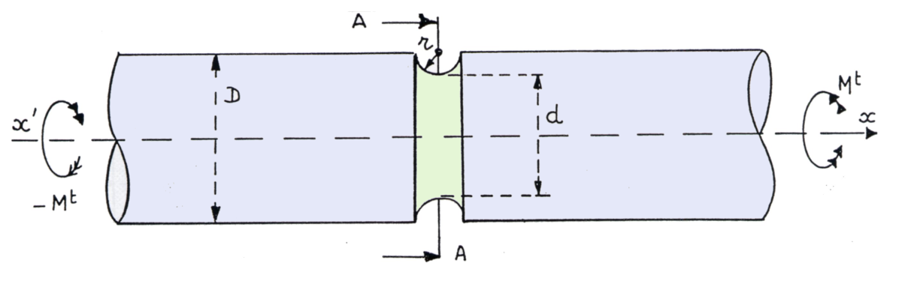
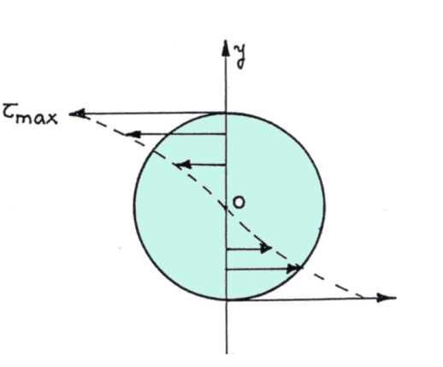
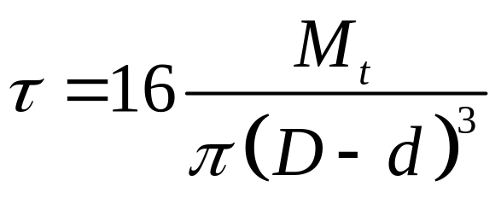
Stress Concentration
Cylindrical shaft transmission
Several Loads - CAUC- 2011

Slide 28
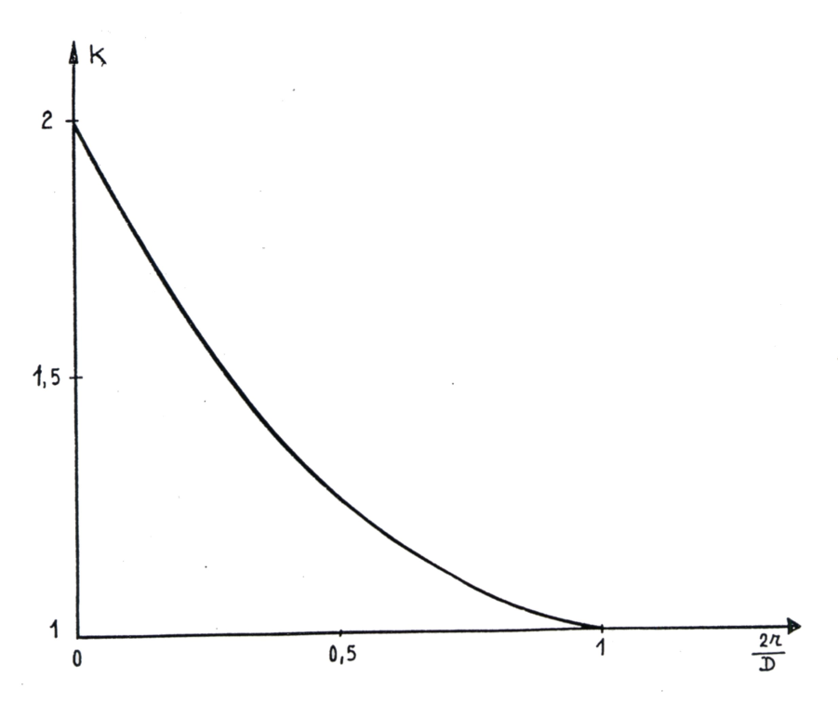

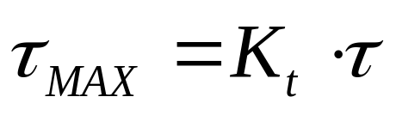
Stress Concentration
Cylindrical shaft transmission
Several Loads - CAUC- 2011

Slide 29
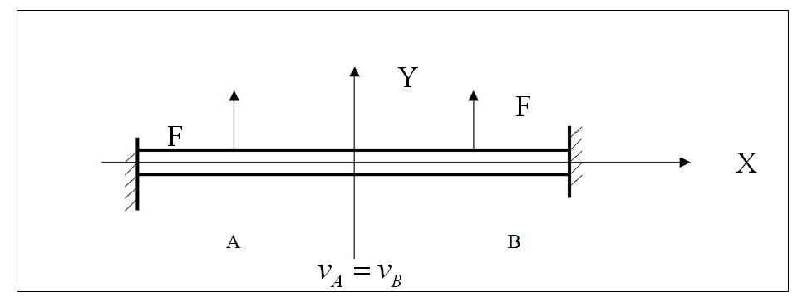


Symetric Structures
Several Loads - CAUC- 2011

Slide 30

Symetric Structures
Several Loads - CAUC- 2011

Slide 31

Anti Symetric Structures
Several Loads - CAUC- 2011

Slide 32

Anti Symetric Structures
Several Loads - CAUC- 2011

